Slide 1
Theorem Prover HOL, overview
Wishnu Prasetya
wishnu@cs.uu.nl
www.cs.uu.nl/docs/vakken/pv

Slide 2
Assumed background
Functional programming
Predicate logic, you know how to read this:
(∀x. foo x = x) ⇒ (∃x. foo x = x)
and know how to prove it.

Slide 3
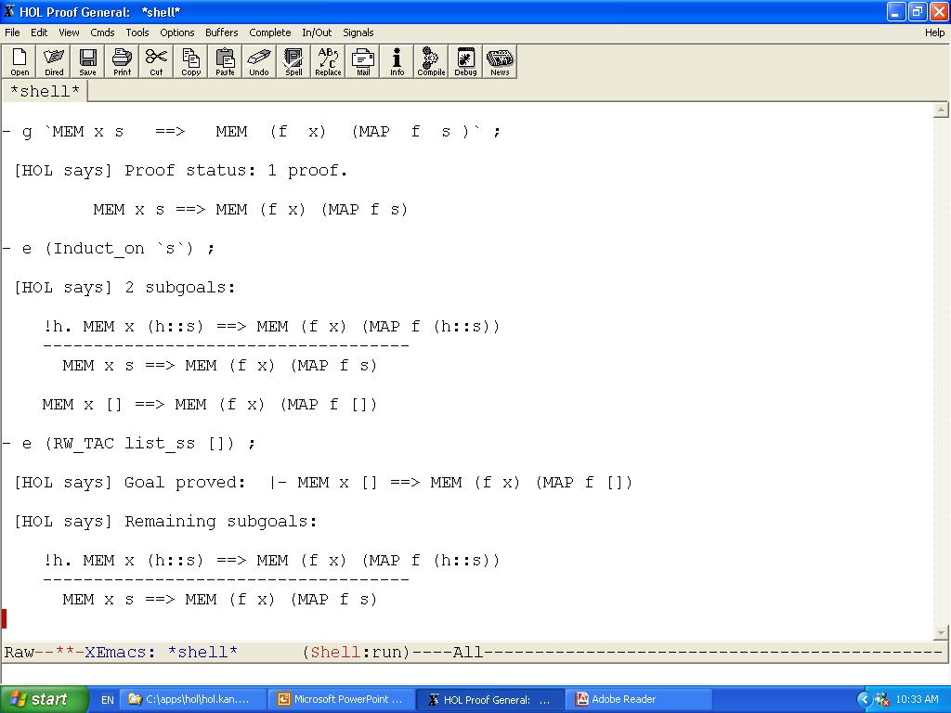
setting up a proof
applying a proof step
the 2-nd subgoal
the 1-st subgoal
solving the first subgoal

Slide 4
Features
“higher order” → highly expressive! (you can model lots of things in HOL)
A huge collection of theories and proof utilities. Well documented.
Safe !
  computer-checked proofs.
  Simple underlying logic, you can trust it.
  Unless you hack it, you cannot infer falsity.
Embedded in ML (yay… an EDSL!)

Slide 5
Non-features
The name “theorem prover” is a bit misleading. Higher order logic is undecidable.
  Don’t expect HOL to do all the work for you!
It doesn’t have a good incremental learning material.
But once you know your way… it’s really a powerful thing.

Slide 6

Embedding in ML
HOL
ML
  ML is a mature functional programming language.
  You can access ML from HOL.
  It gives you powerful meta programming of HOL! E.g. for:
    scripting your proofs
    manipulating your terms
    translating back and forth to other representations

Slide 7

ML → programming level
E.g. these functions in ML:
These are ordinary programs, you can execute them. E.g. evaluating:
after identity identity zero
will produce 0.
val zero = 0 ;
fun identity x = x ;
fun after f g = (fn x=> f (g x)) ;

Slide 8
What if I what to prove properties about my functions?
For example:
We can’t prove this in plain ML itself, since it has no built-in theorem proving ability.
(most programming language has no built-in TP)
Model this in HOL, then verify.
(∀x. after identity identity x = x)

Slide 9


HOL level
We model them in HOL as follows:
The property we want to prove:
val zero_def = Define `zero = 0` ;
val identity_def = Define `identity x = x` ;
val after_def = Define `after f g = (\x. f (g x))` ;
--` !x. after identity identity x = x `--

Slide 10

The proof in HOL
val my_first_theorem = prove (
--`!x. after identity identity x = x`--,
REWRITE_TAC [after_def]
THEN BETA_TAC
THEN REWRITE_TAC [identity_def]
) ;
But usually you prefer to prove your formula first interactively, and later on collect your proof steps to make a neat proof script as above.

Slide 11
Model and the real thing
Keep in mind that what we have proven is a theorem about the models !
E.g. in the real “after” and “identity” in ML :
after identity identity (3/0) = 3/0 → exception!
We didn’t capture this behavior in HOL.
  HOL will say it is true (aside from the fact that x/0 is undefined in HOL).
  There is no built-in notion of exception in HOL, though we can model it if we choose so.

Slide 12

Core syntax of HOL
Core syntax is that of simple typed λ-calculus:
Terms are typed.
We usually interact on its extended syntax, but all extensions are actually built on this core syntax.
term ::= var | const
| term term
| \ var. term
| term : type

Slide 13
Types
Primitive: bool, num, int, etc.
Product, e.g.: (1,2) is a term of type num#num
List, e.g.: [1,2,3] is a term of type num list
Function, e.g.: (\x. x+1) is a term of type num->num
Type variables, e.g.:
(\x. x) is a term of type ‘a -> ‘a
You can define new types.

Slide 14
Extended syntax
(Old Desc ch. 7)
Boolean operators:
~p , p /\ q , p \/ q , p ==> q
Quantifications: // ! = ∀, ? = ∃
(!x. f x = x) , (?x. f x = x)
Conditional:
if ... then ... else ... // alternatively g -> e1 | e2
Tuples and lists → you have seen.
Sets, e.g. {1,2,3} → encoded as int->bool.
You can define your own constants, operators, quantifiers etc.

Slide 15
Examples of modeling in HOL
Define `double x = x + x` ;
Define `skip state = state` ; // higher order at work!
(so … what is the type of skip?).
Define `assign x val
=
(\state. (\v. if v=x then val else state v))` ;
(type of assign?)

Slide 16
Modelling list functions
Define `(sum [ ] = 0)
/\
(sum (x::s) = x + sum s)` ;
Define `(map f [ ] = [ ])
/\
(map f (x::s) = f x :: map f s)` ;

Slide 17
Modeling properties
How to express that a relation is reflexive and transitive?
Define `isReflexive R = (!x. R x x)` ;
(so what is the type of isReflexive?)
Define `isTransitive R
=
(!x y z. R x y /\ R y z ==> R x y)` ;
Your turn. Define the reflexive and transitive closure of a given R.
Notes:
(S contains R) = !x y. R x y ==> S x y
RTclosure R x y = !S. S contains R /\ isRelfexive S /\ isTransitive S ==> S x y
Always have a solution if the domains of x,y are not empty.

Slide 18


Practical thing: quoting HOL terms
(Desc 5.1.3)
Remember that HOL is embedded in ML, so you have to quote HOL terms; else ML thinks it is a plain ML expression.
‘Quotation’ in Moscow ML is essentially just a string:
`x y z` → is just “x y z”
But it is represented a bit differently to support antiquotation:
Notice the backquotes!
val aap = 101
` a b c ^aap d e f `
→ [QUOTE “a b c", ANTIQUOTE 101, QUOTE “d e f"] : int frag list

Slide 19

Quoting HOL terms
The ML functions Term and Type parse a quotation to ML “term” and “hol_type”; these are ML datatypes representing HOL term and HOL type.
Term `identity (x:int)` → returns a term
Type `:num->num` → returns a hol_type
Actually, we often just use this alternate notation, which has the same effect:
--`identity (x:int)`--

Slide 20
A bit inconsistent styles
Some functions in HOL expect a term, e.g. :
prove : term -> tactic -> thm
And some others expect a frag list / quotation ☹
g : term frag list -> proofs
Define : term frag list -> thm

Slide 21
Theorems and proofs

Slide 22

Theorem
HOL terms: --`0`-- --`x = x`--
Theorem : a bool-typed HOL term wrapped in a special type called “thm”, meant to represent a valid fact.
The type thm is a protected data type, in such a way that you can only produce an instance of it via a set of ML functions encoding HOL axioms and primitive inference rules (HOL primitive logic).
  So, if this primitive logic is sound, there is no way a user can produce an invalid theorem.
  This primitive logic is very simple; so you can easily convince yourself of its soundness.
|- x = x

Slide 23

Theorem in HOL
More precisely, a theorem is internally a pair (term list * term), which is pretty printed e.g. like:
Intended to mean that a₁ /\ a₂ /\ ... implies c.
Terminology: assumptions, conclusion.
|- c abbreviates [] |- c.
[a₁, a₂, ...] |- c

Slide 24


Inference rule
An (inference) rule is essentially just a function of type:
thm → thm
E.g. this (primitive) inf. rule :
is implemented by a rule called MP : thm→thm→thm
You can compose your
own:
A |- t₁ ⇒ t₂ , B |- t₁
----------------------------------- Modus Ponens
A @ B |- t₂
fun myMP t₁ t₂ = GEN_ALL (MP t₁ t₂)

Slide 25
Backward proving
Since a “rule” is a function of type (essentially) thm→thm,
it implies that to get a theorem you have to “compose” theorems.
→ forward proof; you have to work from axioms
For human it is usually easier to work a proof backwardly.
HOL has support for backward proving. Concepts :
  Goal → terms representing what you want to prove
  Tactic → a function that reduce a goal to new goals

Slide 26

Goal
type goal = term list * term
Pretty printed:
Represent our intention to prove
[ a₁ , a₂ , ... ] |- h
Terminology : assumptions, hypothesis
type tactic = goal → goal list * proof_func
[ a₁, a₂ , ... ] ?- h

Slide 27

Proof Function
type tactic = goal → goal list * proof_func
So, suppose you have this definition of tac :
// so, just 1 new subgoal
Then the ϕ has to be such that :
ϕ [ A’ |- h’ ] = A |- h
So, a pf is an inference rule, and tac is essentially the reverse of this rule.
tac (A ?- h) = ( [ A’ ?- h’ ] , ϕ )

Slide 28

Proof Tree
A proof constructed by applying tactics has in principle a tree structure, where at every node we also keep the proof function to ‘rebuild’ the node from its children.
g₁
If all leaves are ‘closed’ (proven) we build the root-theorem by applying the proof functions in the bottom-up way.
tac1
g₂
g₃
In interactive-proof-mode, such a ‘proof tree’ is actually implemented as a ‘proof stack’ (show example).
tac2
tac3
(proven)
g₄
tac4
(proven)

Slide 29
Interactive backward proof
(Desc 5.2)
HOL maintains a global state variable of type proofs :
  proofs : set of active/unfinished goalstacks
  goalstack : implementation of proof tree as a stack
A set of basic functions to work on these structures.
  Setting up a new goalstack :
  g : term quotation → proofs
  set_goal : goal → proofs
  Applying a tactic to the current goal in the current goalstack:
  e (expand) : tactic → goalstack

Slide 30
For working on proofs/goalstack...
Switching focus
r (rotate) : int → goalstack
Undo
b : unit → goalstack
restart : unit → goalstack
drop : unit → proofs

Slide 31




Some basic rules and tactics
Shifting from/to asm... (Old Desc 10.3)
A |- v
------------------------ DISCH u
A / {u} |- u ==> v
A ?- u ==> v
-----------------------DISCH_TAC
A + u ?- v
A |- u ==> v
---------------------- UNDISCH
A + u |- v
A ?- v
------------------------ UNDISCH_TAC u
A / {u} ?- u ==> v

Slide 32


Some basic rules and tactics
Modus Ponens (Old Desc 10.3)
A₁ |- t
A₂ |- t ⇒ u
----------------------- MP
A₁ ∪ A₂ |- u
A₁ |- t_{o}
A₂ |- !x. t_{x} ⇒ u_{x}
--------------------------- MATCH_MP
A₁ ∪ A₂ |- u_{o}
A ?- u
A‘ |- t
-------------------- MP_TAC
A ?- t ⇒ u
A ?- u_{o}
A’ |- !x. t_{x} ⇒ u_{x}
--------------------------- MATCH_MP
A ?- t_{o}
A’ should be a subset of A

Slide 33




Some basic rules and tactics
Stripping and introducing ∀ (Old Desc 10.3)
A |- !x. P
---------------- SPEC u
A |- P[u/x]
A ?- P
---------------------- SPEC_TAC(u,x)
A ?- !x. P[x/u]
A |- P
---------------- GEN x
A |- !x. P
A ?- !x. P x
---------------------- GEN_TAC
A ?- P[x’/x]
provided x is not free in A
x’ is chosen so that it is not free in A

Slide 34


Some basic rules and tactics
Intro/striping ∃ (Old Desc 10.3)
A |- P
---------------------- EXISTS (?x. P[x/u], u)
A |- ?x. P[x/u]
A ?- ?x. P
--------------------------- EXISTS_TAC u
A ?- P[u/x]

Slide 35


Rewriting (Old Desc 10.3)
A ?- t
------------------- SUBST_TAC [A’ |- u=v]
A ?- t[v/u]
provides A’ ⊆ A
you can supply more equalities...
A ?- t
------------------- REWRITE_TAC [A’ |- u=v]
A ?- t[v/u]
also performs matching e.g. |- f x = x will also match “... f (x+1)”
recursive
may not terminate!

Slide 36
Tactics Combinators (Tacticals)
(Old Desc 10.4)
The unit and zero ☺
  ALL_TAC // a ‘skip’ ☺
  NO_TAC // always fail
Sequencing :
  t1 THEN t2 → apply t1, then t2 on all subgoals generated by t1
  t THENL [t1,t2,…] → apply t, then t_{i} on i-th subgoal generated by t
  REPEAT t → repeatedly apply t until it fails (!)

Slide 37
Examples
DISCH_TAC ORELSE GEN_TAC
REPEAT DISCH_TAC
THEN EXISTS_TAC “foo”
THEN ASM_REWRITE_TAC [ ]
fun UD1 (asms,h)
=
( if null asms then NO_TAC
else UNDISCH_TAC (hd asms) ) (asms,h) ;

Slide 38
Some common proof techniques
(Desc 5.3 – 5)
Power tactics
Proof by case split
Proof by contradiction
In-line lemma
Induction

Slide 39
Power Tactics: Simplifier
Power rewriter, usually to simplify goal :
SIMP_TAC: simpset→ thm list → tactic
standard simpsets: std_ss, int_ss, list_ss
Does not fail. May not terminate.
Being a complex magic box, it is harder to predict what you get.
You hope that its behavior is stable over future versions.

Slide 40
Examples
Simplify goal with standard simpset:
SIMP_TAC std_ss [ ]
(what happens if we use list_ss instead?)
And if you also want to use some definitions to simplify:
SIMP_TAC std_ss [ foo_def, fi_def , … ]
(what’s the type of foo_def ? )

Slide 41
Other variations of SIMP_TAC
ASM_SIMP_TAC
FULL_SIMP_TAC
RW_TAC does a bit more :
  case split on any if-then-else in the hypothesis
  Reducing e.g. (SUC x = SUC y) to (x=y)
  “reduce” let-terms in hypothesis

Slide 42
Power Tactics: Automated Provers
1-st order prover: PROVE_TAC : thm list -> tactic
Integer arithmetic prover: ARITH_TAC, COOPER_TAC (from intLib)
Natural numbers arith. prover: ARITH_CONV (from numLib)
Undecidable.
They may fail.
Magic box.

Slide 43
Examples
Simplify then use automated prover :
RW_TAC std_ss [ foo_def ]
THEN PROVE_TAC [ ]
In which situations do you want to do these?
RW_TAC std_ss [ foo_def ]
THEN TRY (PROVE_TAC [ ])
RW_TAC std_ss [ foo_def ]
THEN ( PROVE_TAC [ ] ORELSE ARITH_TAC )

Slide 44
Case split
ASM_CASES_TAC : term → tactic
Split on data constructors, Cases / Cases_on
A ?- u
------------------------------ ASM_CASES_TAC t
  t + A ?- u
  ~t + A ?- u
A ?- ok s
---------------------------------- Cases_on `s`
  A ?- ok [ ]
  A ?- ok (x::t)

Slide 45
Induction
Induction over recursive data types: Induct/Induct_on
Other types of induction:
  Prove/get the corresponding induction theorem
  Then apply MP
?- ok s
---------------------------------- Induct_on `s`
  ?- ok [ ]
  ok t ?- ok (x::t)

Slide 46


Adding “lemma”
by : (quotation * tactic) → tactic // infix
A ?- t
--------------------------------- lemma by tac
lemma + A ?- t
If tac proves the lemma
A ?- t
--------------------------------- lemma by tac
(1) lemma + A ?- t
(2) A ?- z
If tac only reduces lemma to z

Slide 47
Adding lemma
But when you use it in an interactive proof perhaps you want to use it like this:
`foo x > 0` by ALL_TAC
What does this do ?

Slide 48
Proof by contradiction
SPOSE_NOT_THEN : (thm→tactic)→tactic
SPOSE_NOT_THEN f
  assumes ¬hyp |- ¬hyp.
  now you must prove False.
  f (¬hyp |- ¬hyp) produces a tactic, this is then applied.
Example:
A ?- f x = x
----------------------------- SPOSE_NOT_THEN ASSUME_TAC
~(f x = x) + A ?- F

